Slide 1
Coursera Capstone Project
Muhammad Hamza

Slide 2
Introduction

Slide 3
Problem
With a population exceeding 150 Million, Lahore is undoubtedly one of the largest cities of Pakistan, the 5th largest country by population. However, Lahore has had a history of being unable to provide adequate medical care to its citizens, especially in the relatively underdeveloped areas.
As the government has a low amount of resources, there is only a small number of hospitals that can be built to cover a number of areas. Some areas are fully covered while some areas are not covered at all. The number of hospitals to be built should cover areas with the lowest amount of healthcare facilities in their vicinity.

Slide 4
Solution
In order to cater the current problem, I plan to create a map that would display the neighborhoods and the number of hospitals near them. These hospitals will be judged on the number of areas they cater, which will in turn identify the areas to which hospitals are very far. These identified points will then be used to analyze and determine the optimal points for building a new hospital.

Slide 5
142
Total areas in Lahore

Slide 6
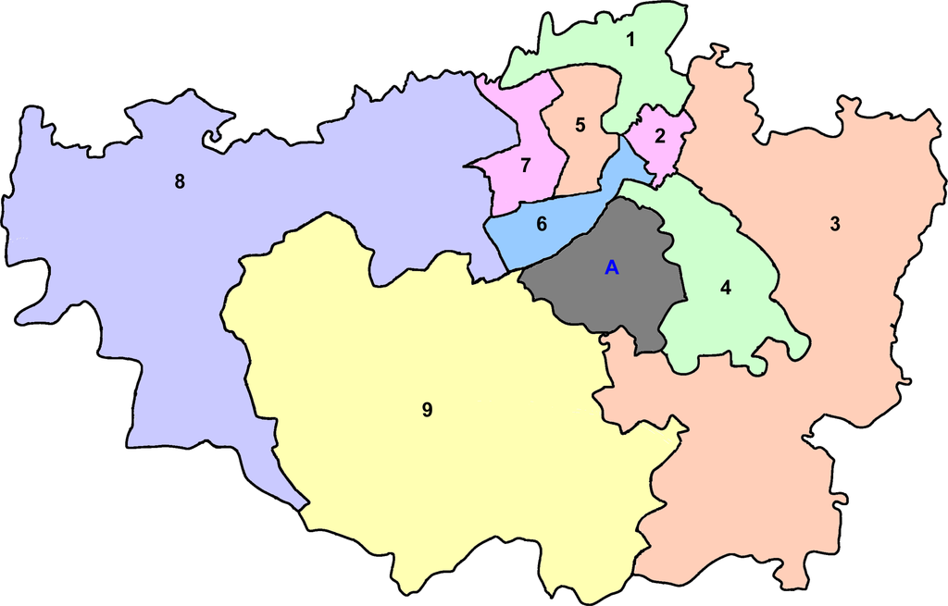
Administrative areas in lahore
9

Slide 7
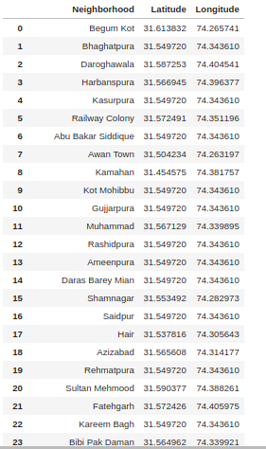
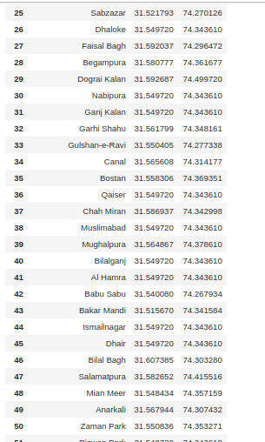
A small part of list of the latitude and longitude of towns in Lahore represents tightly knit towns

Slide 8
78
Hospitals in Lahore, ~2 per area

Slide 9
Major problem when it comes to healthcare in Lahore

Slide 10
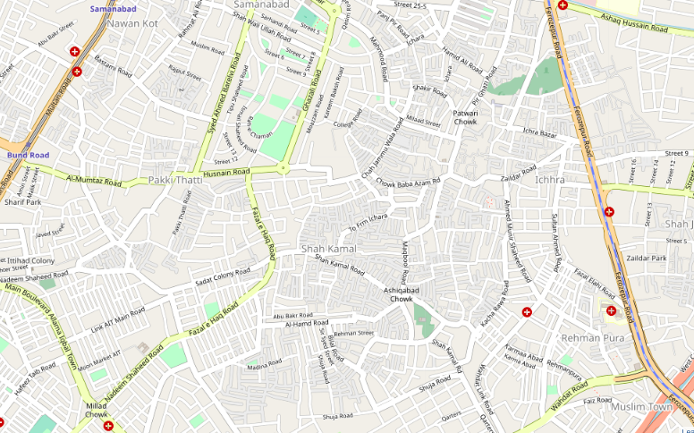
After mapping on folium, the hypothesis was confirmed; Some areas are not populated at all with healthcare facilities

Slide 11
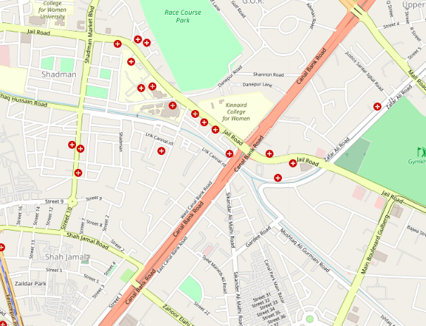
Whereas others are overpopulated, too many healthcare facilities concentrated

Slide 12
Areas in critical need of healthcare
Shah Kamal
Pakki Thatti
Gulshan Ravi
Harbanspura
Mehmood Booti
Gurawala Colony

Slide 13
Conclusion
Healthcare facilities are an important factor for any budding community.
Many areas do not get proper medical care due to lack of facilities.
Governments need to make decisions in order to effectively position areas where to create public facilities that can be of use to everyone.
Experiment can be further explored to pinpoint the exact coordinates where the hospitals or other public facilities may be built.
This would not only help the people but also help the government in making rational decisions for effective governance.

